Slide 1
Insights into Future Video Codec
Huawei Technologies
2014.10.21

Slide 2
Contents
1.
Video 2020—Mobility and Sociality
2.
Requirements for Future Video Codec

Slide 3
Landscape of Video 2020
Instagram
Mobility and Sociality are the two driving forces for new video based applications.
With the development of Smart and wearable personal devices, mobile video applications will become more and more important.
The easy-to-use mobile and social video applications will generate much more video data than traditional streaming/broadcasting video.
Video surveillance will be more pervasive, which has generated more video than youtube (Dropcam, 2013).
Not video call or face time, but Event Time, to show your friend what you are seeing.

Slide 4
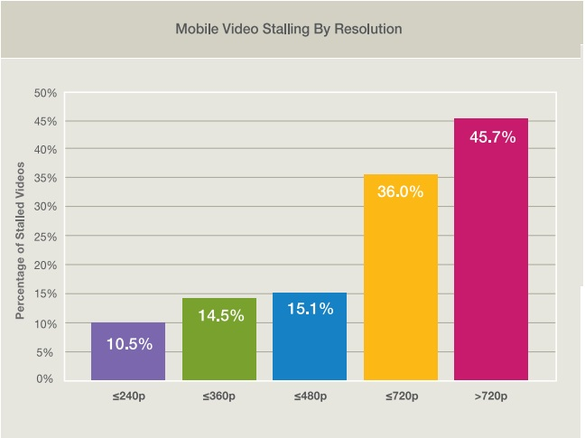
Reality :Powerful Devices vs Slow Networks
Cisco VNI 2014: By 2018, mobile video will represent 69% of global mobile traffic (up from 53% in 2013).
Citrix Mobile Analytics Report Feb. 2014:On LTE networks, mobile videos stall for an average of 15 seconds per 60 seconds of video.
Source : Mobile Video Report 2014 Q3 , Joint Lab of Huawei mLab and Sohu Video.
In cellular networks, more than 50% bandwidth is consumed by video and will be more in future
But the main-stream video quality is not better than 360p
Current mobile networks can not support good QoE video services
Network bandwidth is still the bottleneck for massive mobile video services
Notes:
https://blogs.cisco.com/news/cisco-vni-global-mobile-data-forecast-update-2013-2018/
http://www.citrix.com/content/dam/citrix/en_us/documents/products-solutions/mobile-analytics-report-feb-2014.pdf?accessmode=direct
http://www.citrix.com/content/dam/citrix/en_us/documents/products-solutions/bytemobile-mobile-analytics-report-november-2013.pdf

Slide 5
Contents
1.
Video 2020—Mobility and Sociality
2.
Requirements for Future Video Codec

Slide 6
Co-existence of 3G,4G and 5G@2020
The current user and network model in downtown area
Densest RAN distribution in downtown area- CMCC
User Model | 40000 users per km2 Peak concurrency of video users: 5% [Revenue]
Network Model | 300m between access point 10 cells per km2 [Cost] 30~100MHz frequency bandwidth
300m
300m
300m
300m
Trade off between cost of network deployment and QoE
300m
LTE
386Mbps/km2
LTE-A 2.6Gbps/km2
4.5G
10Gbps/km2
5G
1000Gbps/km2
2014 2016 2019 2023
LTE and its evolvement will be the main way for MBB streaming in next decade
How to improve revenue while control the cost is important
Notes:
http://wenku.baidu.com/link?url=zh8e3eriYLJmrxF8AeqtZs4vzWZ2nSqYNY50P9Yn8GyVEAS8Unrp6dbsyeA9jeO9eZalymILX1zAaPKBSjGtxlJfIAFlEJkC3AmXVsuFc5q
LTE and its evolution will be the main way for MBB streaming in the next decade

Slide 7
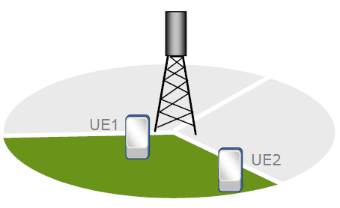
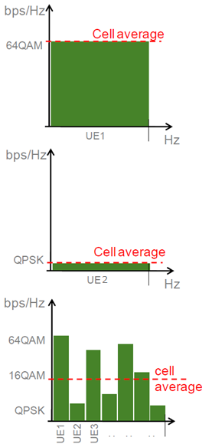
Cost down while QoE up
Network | Avg.DL Rate/Cell | Resolution @ Frame Rate | Source Rate (Mbps) | AVC → HEVC (bandwidth requirements) | AVC → HEVC (Users/Cell)
3G | 2Mbps@ 5MHz | 416x240@10 | 34 | 350Kbps →175Kbps | 5 → 10
LTE | 38.6Mbps@ 20MHz | 640x480@30 | 105 | 1Mbps →500Kbps | 40 → 80
 |  | 832x480@30 | 137 | 1.5Mbps →750kbps | 25 → 50
LTE-A | 260Mbps@ 100MHz | 1280x720@30 | 316 | 3Mbps →1.5Mbps | 86 → 172
 |  | 1920x1080@30 | 712 | 8Mbps→4Mbps | 32 → 65
HEVC provides better solution with less cost per bit
At the same time, smaller video size help to conquer fluctuation of wireless network and reduce the times of video stall
Also HEVC helps to improve resolution of video, which is important for some advanced video based mobile applications, such as insurance company’s investigation of a car accident.

Slide 8
Call afore a new hero!
25% compression improvement is not enough for a new codec
Bring forward a wave for High Quality Mobile Video
LTE
386Mbps/km2
LTE-A 2.6Gbps/km2
4.5G
10Gbps/km2
5G
1000G/km2
Users Concurrency | 2% (80/Cell) | 5% (200/Cell) | 10% (400/Cell)
Avg. DL/UL BW/User UL BW ~= 1/3 DL BW | 0.48Mbps/0.16Mbps | 1.3 Mbps/0.43Mbps | 2.5Mbps/0.8Mbps
DL/UL Users/Cell for FHD quality@HEVC(4Mbps) | 12/4 | 65/21 | 250/125
2X
LTE will fail to meet the growing demand for mobile video.
With the improvement of QoE and user bandwidth, more and more user will be using the mobile video services.
It is expected that LTE-A and the so called 4.5G will be the most popular MBB access points.
A HD level mobile video quality is expected for mobile video services.
A 2X better than HEVC codec will be basic for really massive video applications and services over Mobile Network for the next decade.
Notes:
http://wenku.baidu.com/link?url=zh8e3eriYLJmrxF8AeqtZs4vzWZ2nSqYNY50P9Yn8GyVEAS8Unrp6dbsyeA9jeO9eZalymILX1zAaPKBSjGtxlJfIAFlEJkC3AmXVsuFc5q

Slide 9
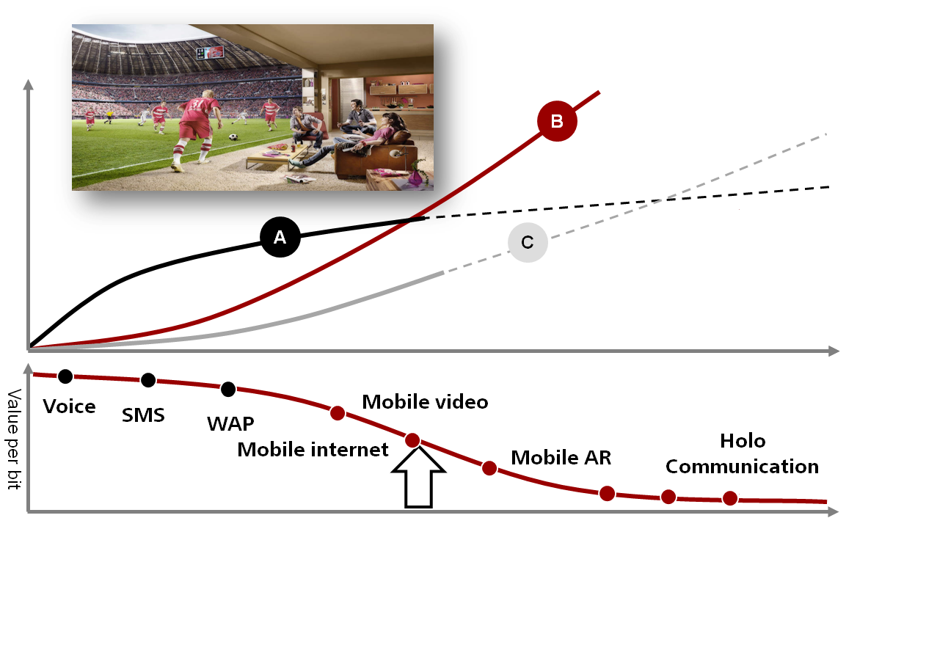
Needs for a dilemma-breaker!
A: Improve Revenue of CSP ↑
B: Improve User Experience ↑
C: Reduce Cost per Bit ↓
Make New Services Possible

Slide 10
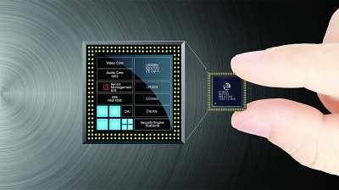
Balance equation：2X Performances@2X Complexities
2006 2008 2010 2012 2014 2016 2018 2020
Improvement of gates per unit
Cortex-A53
Future Codec
Cortex-A15
Cortex-A9
Cortex-A7
Chip Cost
Power Consumption
Cortex-A5
HEVC
AVC
Chip Manufacturing Technology Improvement
In the past decade, chip manufacture technologies have been improved greatly.
Mobile processors are getting higher frequency and cores.
Mobile device consumers are aware of power efficiency and functionalities greatly.
The improvement of chip technologies will provide more computing ability for higher level functions while keeping the power consumption at a acceptable level.
The development of future codec should take chip tech. into consideration.

Slide 11
Performance vs. Royalty Free
Video Codec is a enabling technology for video services.
For the current mobile video applications, cost per video bit is still too high for massive video services market which are blocking the development of innovation of video based mobile applications.
It is important to have a better video codec for mobile video services first.
Healthy balance between the royalty cost and the investment of new codec technologies is important.

Slide 12
Thank You.
www.huawei.com
Copyright ©2010 Huawei Technologies Co.,Ltd. All Rights Reserved.
The information contained in this document is for reference purpose only, and is subject to change or withdrawal according to specific customer requirements and conditions.
©2010 华为技术有限公司 版权所有
本资料仅供参考，不构成任何承诺及保证

Slide 13
Original questions
What will be the applications with highest amount of video data delivery 5-10 years from now?
Do you see market segments where HEVC may not be successful due to lack of functionality?
How much additional compression (compared to HEVC) do you foresee to be needed for your market(s)? What are the desirable frame rates and resolutions?
How would it affect your business (and in what time frame) if a new video codec would deliver 25% reduction in data rate for the same video quality compared to HEVC?
What should be “the bar” to surpass to make a new standard? (in terms of tradeoff of compression benefit versus complexity, compatibility with existing designs, etc.)
What would change if the industry uses the new codec as (partly or totally) royalty-free?

