Slide 1
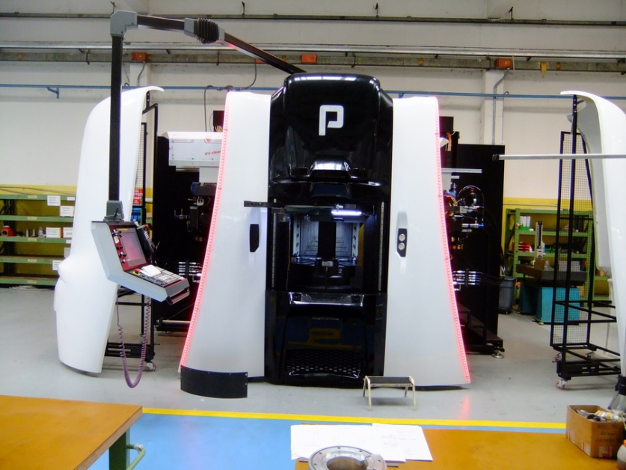
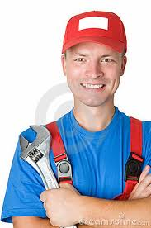
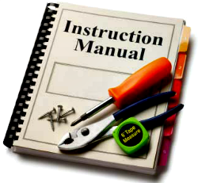
Machine Maintenance
Maintenance of industrial machinery is complex
Operators may not know all procedures
Bringing and using a printed manual is cumbersome
?
?
?
?
?

Slide 2
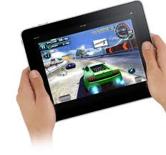
Smart Maintenance
Smart Maintenance Assistant
The operator points to the Multicenter
The system recognizes the components and returns relevant information

Slide 3
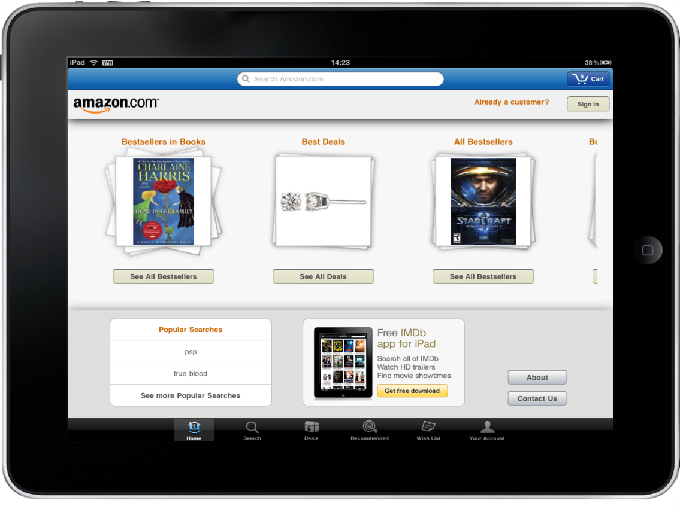
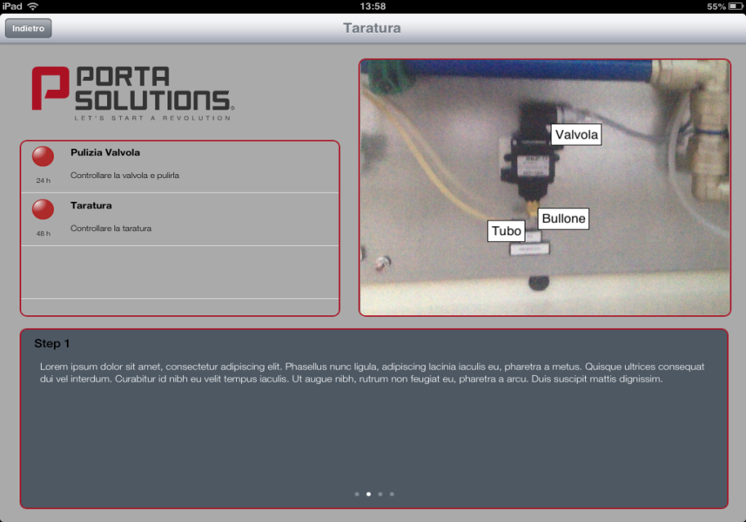
The Demo
Mobile App app
Developed for Porta Solutions, Italian producer of Multicenter and Transfer machines
See you at the demo!

