Slide 1
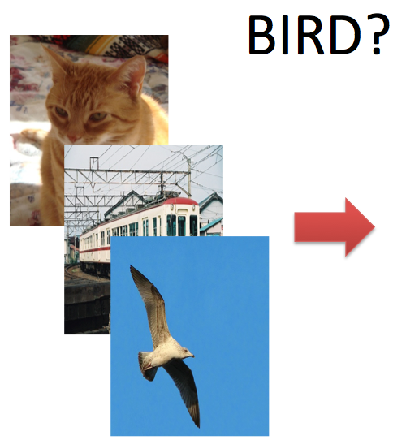
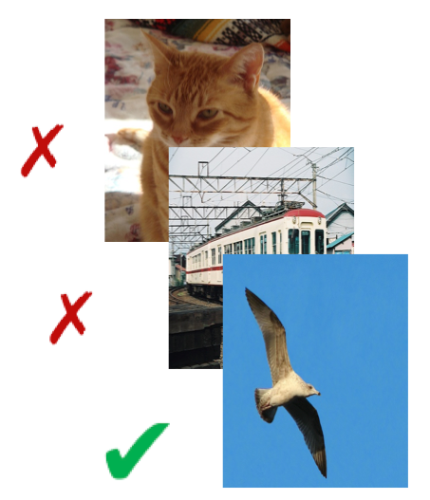
Object Classification with CDVS
CDVS Descriptors for Digital Asset Management
CDVS was designed to find (recognise) specific objects, as depicted by the Query image
Can we use CDVS for generic classification? e.g. Cat, Train..
Object Classification is very useful in Digital Asset Management Systems

Slide 2
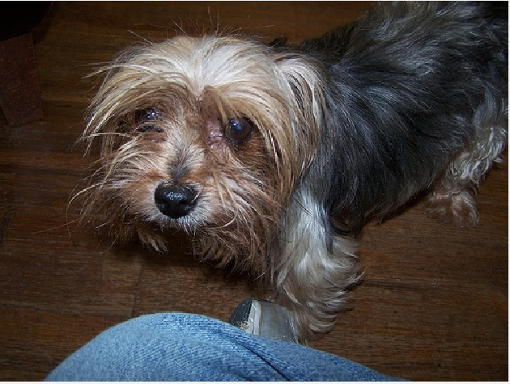
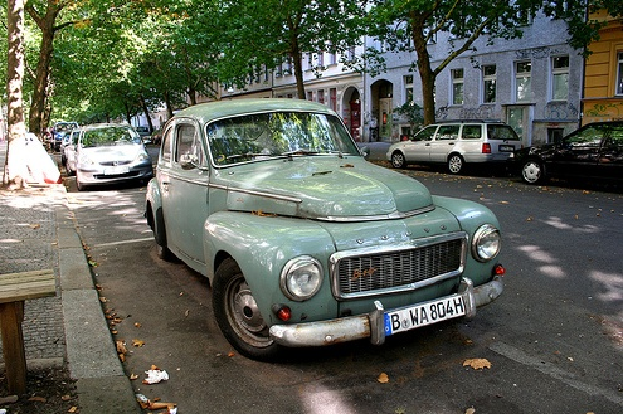
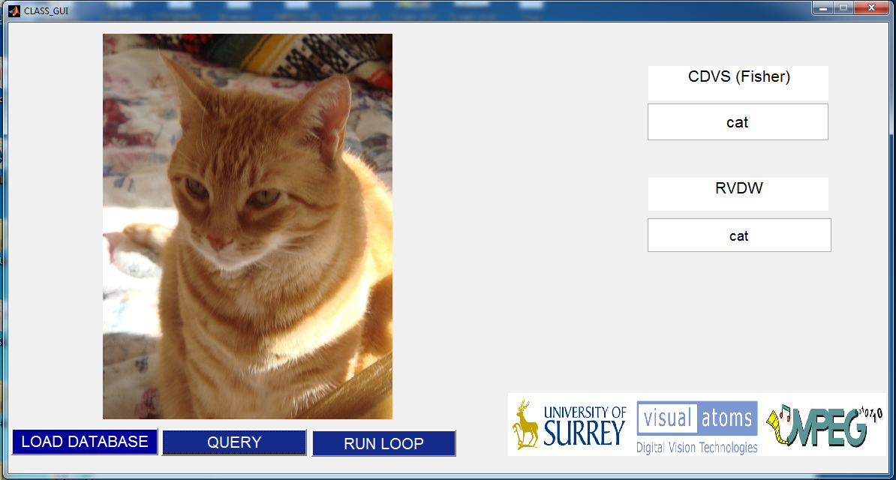
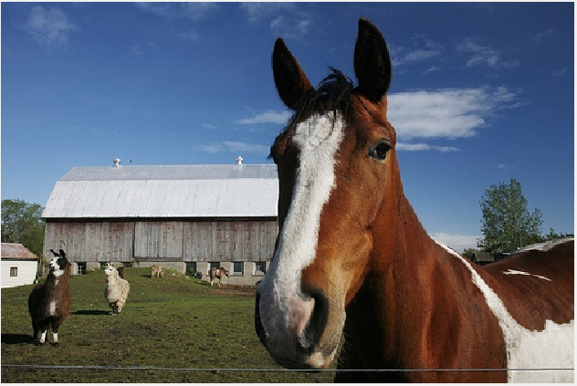
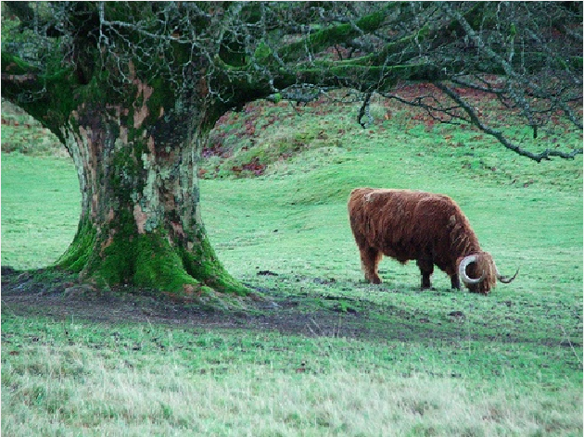

What is shown on the image?
CDVS for Object Classification
CAR
DOG
HORSE
COW
BOAT

Slide 3

The ultimate challenge
CDVS for Object Classification

